Slide 1
Unit 6: Capstone Project
Date-A-Scientist
Machine Learning Fundamentals
Charles Blackshear
November 12, 2018

Slide 2
Table of Contents
Exploration of the Dataset
Questions to Answer
Augmenting the Dataset
Classification Approaches
Regression Approaches
Conclusions / Next Steps

Slide 3
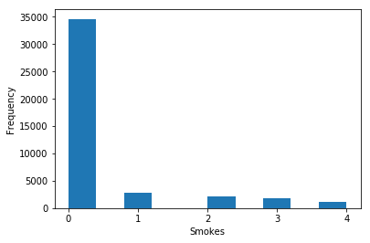
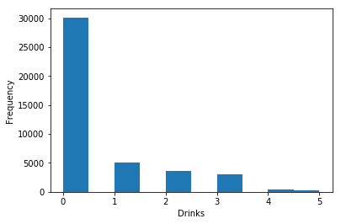
Exploration of the Dataset
The overwhelming majority deny any smoking. Most characterize their drinking as “social”
Smoking = "no": 0, "sometimes": 1, "when drinking": 2, "yes": 3, "trying to quit": 4
Drinking = "socially": 0, "rarely": 1, "often": 2, "not at all": 3, "very often": 4, "desperately": 5

Slide 4
Questions to Answer
Can we predict drug use based on a user’s smoking and drinking activities?
Can we predict with the user’s age the preference for either a serious or a casual relationship?

Slide 5
Augmenting the Dataset
Textual responses to smoking, drinking and drug use questions were mapped to discrete integers and assigned to new columns:
  df1["smokes_code"] = df1.smokes.map(smokes_mapping)
  df1["drinks_code"] = df1.drinks.map(drinks_mapping)
  df1["drugs_code"] = df1.drugs.map(drugs_mapping)
The “ae.word_hits” column was created to record the number of times each user utilized in their essays a word designated in the serious vs casual text search string
The “ae.wh_zscore” and “ae.age_zscore” columns were created to z-score normalize the respective Word Hits and Age axes

Slide 6
Classification Approaches
Can we predict drug use based on a user’s smoking and drinking activities?
  K-Nearest Neighbors
  Support Vector Machines

Slide 7
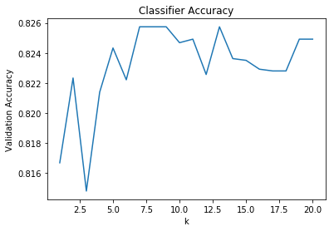
Classification Summary
KNN classifier used k = 8 based on accuracy plot
KNN classifier accuracy using score function: 0.826 or 83%
KNN classifier accuracy using predict & accuracy_score functions: 0.826, as expected
SVM classifier accuracy using score function: 0.817 or 82%
SVM classifier accuracy using predict & accuracy_score functions: 0.817, as expected

Slide 8
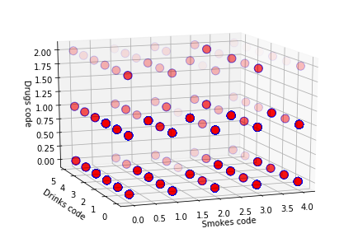
Classification Summary
Drug use characterized as “sometimes” graphically correlates with smoking and drinking, thus corroborating the results of the KNN and SMV classifiers
Relatively less commonly do smokers and drinkers engage in drug use “often”. This is likely true of the user population, in general

Slide 9
Regression Approaches
Can we predict with the user’s age the preference for either a serious or a casual relationship?
  Linear Regression
  K-Nearest Neighbors Regression
The use of designated “serious” or “casual” dating terms were used as a proxy for the user’s level of commitment
  Serious relationship text search string: "marriage", "committed", "serious"
  Casual relationship text search string: "casual", "fling", "NSA”
All nine essays from each user were evaluated

Slide 10
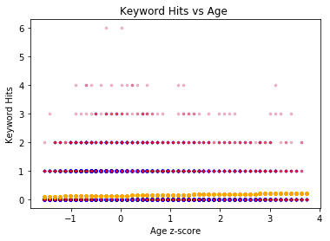
Linear Regression Summary
Y-axis: Number of times a “serious” relationship term was used in the essays
X-axis: User age, z-score normalized to more closely match Keyword Hits on the y-axis
User data is represented by red circles
Linear regression is represented by orange circles
R² = 0.00357

Slide 11

KNN Regression Summary
Y-axis: Number of times a “serious” relationship term was used in the essays
X-axis: User age, z-score normalized to more closely match Keyword Hits on the y-axis
User data is represented by red circles
Linear regression is represented by orange circles
R² = -0.0107

Slide 12
Regression Summary
Performance of the regression when the “casual” relationship text search string (i.e. “casual”, “fling”, “NSA”) is employed
  Linear Regression: R² = 0.000743
  K-Nearest Neighbors Regression: R² = -0.00712

Slide 13
Conclusions
Can we predict drug use based on a user’s smoking and drinking activities?
  Yes, smoking and drinking are predictive of drug use
Can we predict with the user’s age the preference for either a serious or a casual relationship?
  We cannot predict a user’s level of commitment based on age if we make the assumption that users interested in either a serious or a casual relationship use the corresponding terms in the aforementioned text search strings
  The low R² values could reflect a poor fit of the regressors to the user data, or could more generally speak to the inability of regression schemes to predict human behavior
  Next steps include more sophisticated Boolean search terms (i.e. ”marriage” and “committed” but no “casual” or “fling”). Naturally, additional user data directly addressing the user’s commitment preference would be the gold-standard

